Slide 1
Ο τομέας της Υγείας και Φαρμάκου στο νέο Πρόγραμμα Πλαίσιο της Ευρωπαϊκής Επιτροπής για Έρευνα, Τεχνολογική Ανάπτυξη και Καινοτομία "Ορίζοντας 2020»
Τομέας: Υγεία & Φάρμακα
1^{η} ΣΥΝΑΝΤΗΣΗ ΟΜΑΔΑΣ ΕΡΓΑΣΙΑΣ
24 Ιανουαρίου 2014
ΙΝΣΤΙΤΟΥΤΟ ΠΑΣΤΕΡ
Θεόδωρος Φώτσης
Department of Biomedical Research
Institute of Molecular Biology and Biotechnology
Foundation for Research & Technology -Hellas (FORTH/IMBB-BR)
&
Laboratory of Biological Chemistry, Medical School
University of Ioannina

Slide 2
What is Horizon 2020
Commission proposal for a 80 billion euro research and innovation funding programme (2014-2020)
A core part of Europe 2020, Innovation Union & European Research Area:
Responding to the economic crisis to invest in future jobs and growth
Addressing people’s concerns about their livelihoods, safety and environment
Strengthening the EU’s global position in research, innovation and technology

Slide 3
Impact of Horizon 2020 for R&I
Key Features of
projects
Societal Impact and Contribution to Europe 2020
Research and innovation outputs of Horizon 2020
Improved R&D capabilities
Scientific publications
New tools and techniques
Models and simulations
Prototypes, demonstrators, pilots
Patents
New products, processes, services
Spin-offs
Economic growth
€1 invested produces €10 extra GDP per annum
Excellence
Horizon 2020
pan-European competition
More high-tech Jobs
>800,000 in the medium term
collaborative projects with critical mass
Competitiveness
Exports increase by 1,4% and imports decrease by 0,2% in the medium term
not achievable without EU support
leveraging additional private & public resources
Inclusive & sustainable growth
Better health & more well-being
A more secure society
Sustainable agriculture
Clean & efficient energy
Smart, green, integrated transport
Reduced greenhouse gas emissions
Efficient use of natural resources
support from idea to market
Easy access for all participants including SMEs

Slide 4
Simplification
Single set of simpler and more coherent participation rules
New balance between trust and control
Moving from several funding rates for different beneficiaries and activities to just two
Replacing the four methods to calculate overhead or «indirect costs» with a single flat rate
Major simplification under the forthcoming financial regulation
Successful applicants to get working more quickly: reduction of average time to grant by 100 days (current average of around 350 days under FP7)

Slide 5
Three Priorities
I
Excellent Science
European Research Council (ERC)
2. Future and Emerging Technologies (FET)
3. Marie Sklodowska-Curie (MSCA)-actions
4. Research infrastructures
II
Industrial Leadership
Leadership in enabling and industrial technologies
1 ICT
1.2 Nanotechnologies
1.3 Advanced materials
1.4 Biotechnology
1.5 Manufacturing and processes
1.6 Space
Access to risk finance
Innovation in SMEs
III
Societal Challenges
Health, demographic change and wellbeing
Food security, sustainable agriculture and inland water research and the bioeconomy
Secure, clean and efficient energy
Smart, green and integrated transport
Climate action, resourse efficiency and raw materials
6. Europe in a changing world- inclusive, innovative and reflective societies
7. Secure societies-protecting freedom and securty of Europe and its citizens
Joint Research Centre (JRC); EIT (European Institute of Technology)

Slide 6
Priority 1. Excellent science
Why:
World class science is the foundation of tomorrow’s technologies, jobs and wellbeing
Europe needs to develop, attract and retain research talent
Researchers need access to the best infrastructures

Slide 7
European Research Council – grant schemes
Starting Grants
starters
(2-7 years after PhD)
up to € 2.0 Mio
for 5 years
Consolidator Grants
Consolidators
(7-12 years after PhD)
up to € 2.75 Mio
for 5 years
Advanced Grants
track-record of significant research achievements in the last 10 years
up to € 3.5 Mio
for 5 years
Synergy Grants
2 – 4 Principal Investigators
up to € 15.0 Mio for 6 years
Proof-of-Concept
bridging gap between research - earliest stage of marketable innovation up to €150,000 for ERC grant holders

Slide 8
MSCA - scope of activities
Innovative Training Networks | ITN | International and interdisciplinary consortia for doctoral and early-stage training European Training Networks, European Industrial Doctorates, European Joint Doctorates
Individual Fellowships | IF | Grants for post-doctoral researchers undertaking international and inter-sector mobility Dedicated support for career restart and reintegration of researchers European Fellowships and Global Fellowships
Research and Innovation Staff Exchange | RISE | International and inter-sector cooperation and transfer of knowledge through the exchange of staff
Co-funding of programmes | COFUND | Co-funding of regional, national and international programmes: doctoral programmes fellowship programmes
Policy support actions | NIGHT NCP | European Researchers' Night (NIGHT) NCP support Non call-based activities (studies and support to Alumni)

Slide 9
Priority 2. Industrial leadership
II
Industrial Leadership
Leadership in enabling and industrial technologies
1 ICT
1.2 Nanotechnologies
1.3 Advanced materials
1.4 Biotechnology
1.5 Manufacturing and processes
1.6 Space
Access to risk finance
Innovation in SMEs
Why:
Strategic investments in key technologies (e.g. advanced manufacturing, micro-electronics) underpin innovation across existing and emerging sectors
Europe needs to attract more private investment in research and innovation
Europe needs more innovative SMEs to create growth and jobs

Slide 10
SME instrument
10-15% success
50% success
10% of budget
6 months
90% of budget
12-24 months
Approx. 2% of budget
Coaching
Concept & Feasibility Assessment
Demonstration
Market Replication
R&D
Commercialisation
SME window EU financial facilities
Idea to concept,
risk assessment, technological & commercial feasibility
Demonstration, prototyping, testing , market replication, scaling up, miniaturisation, research
Quality label for successful projects, access to risk finance, indirect support
IDEA continued support throughout the project
MARKET

Slide 11
SME support: integrated approach
20 % budgetary
target in LEITs & SC
Collaborative projects
13%
SME instrument
7%
Eurostars II Enhancing Innovation Capacity Market-driven Innovation
Access to Risk Finance
'Innovation in SMEs'

Slide 12
Next calls

Slide 13
Priority 3. Societal challenges
III
Societal Challenges
Health, demographic change and wellbeing
Food security, sustainable agriculture and inland water research and the bioeconomy
Secure, clean and efficient energy
Smart, green and integrated transport
Climate action, resourse efficiency and raw materials
6. Europe in a changing world- inclusive, innovative and reflective societies
7. Secure societies-protecting freedom and securty of Europe and its citizens
Why:
Concerns of citizens and society/EU policy objectives (climate, environment, energy, transport etc) cannot be achieved without innovation
Breakthrough solutions come from multi-disciplinary collaborations, including social sciences & humanities
Promising solutions need to be tested, demonstrated and scaled up

Slide 14
Health, demographic change and wellbeing challenge
Less prescription – what to do, but not how to do it
Strengthening competitiveness of EU industries - development of new market opportunities
Multidisciplinary approach - fostering cooperation between academic and industrial sectors
Also implemented by the Innovative Medicines Initiative (IMI) 2; European & Developing Countries Clinical Trials Partnership (EDCTP); Ambient Assisted Living (AAL) 2

Slide 15
Work programme
Work programmes with a 2 year-duration!
15 topics in the ‘co-ordination activities’ call (7 ERA-NET)
36 topics in the ‘personalising health and care’ focus area call
Objectives:
Create opportunities for real breakthrough research
Translation of findings into the clinic
Reduce health inequalities
Promote active and healthy ageing

Slide 16
Personalising health and care
Understanding health, ageing and disease – 3 topics
Effective health promotion, disease prevention, preparedness and screening – 6 topics
Improving diagnosis – 3 topics
Innovative treatments and technologies – 6 topics
Advancing active and healthy ageing – 4 topics
Integrated, sustainable, citizen-centred care – 8 topics
Improving health information, data exploitation and providing an evidence base for health policies and regulation – 6 topics

Slide 17
BioMedical informatics in H2020 (I)
Societal challenge
Challenge 1: Health, demographic change and wellbeing (I)
Using in-silico medicine for improving disease management and prediction.
Computer simulation using patient data
Transferring knowledge to clinical practice and scalable innovation actions.
Transferring BMI knowledge to application
Better use of health data
Data processing, KM, modelling and visualisation

Slide 18
BioMedical Informatics within H2020 (II)
Societal challenge
Challenge 1: Health, demographic change and wellbeing (II)
Individual empowerment for self-management of health
Personalised health technologies and services
Active aging, independent and assisted living
User friendly solutions for ageing population
Promoting integrated care
Innovative solutions supporting the management of chronic disease
Optimising the healthcare systems
Disseminating innovative technologies and approaches

Slide 19
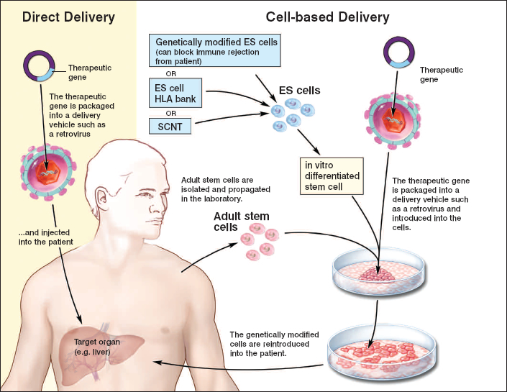
Κυτταρική & γονιδιακή θεραπεία

Slide 20
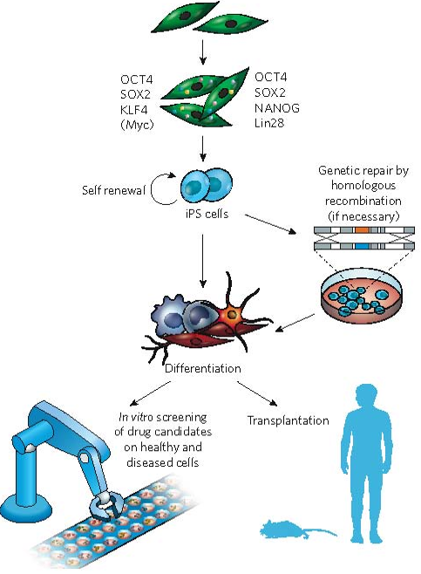
Τα iPS κύτταρα μπορούν να χρησιμοποιηθούν για ανάπτυξη εξατομικευμένης θεραπείας
Notes:
In 2006, it was shown, by Kazutoshi Takahashi and Shinya Yamanaka83,
for the first time that overexpression of only four proteins — OCT4, SOX2,
Myc and KLF4 — in mouse embryonic or adult fibroblast cultures could
generate pluripotent stem-cell-like cells (see figure). Just a year later, the
same group84 and a another group, led by James Thomson85, succeeded
independently in generating human induced pluripotent stem (iPS)
cells from adult skin fibroblasts. Thomson’s group used overexpression
of OCT4 and SOX2, in combination with two other proteins, NANOG
and Lin28, instead of Myc and KLF4. In both studies, iPS cells showed
the essential characteristics of ES cells in terms of their morphology,
cell-surface markers, gene-expression profiles and telomerase activity.
Furthermore, iPS cell clones could be maintained in culture for several
months at least and could be induced to differentiate into derivatives of all
three embryonic germ layers both in vitro and in vivo in mouse teratomas.
Reactivation of Myc increased tumorigenicity in chimaeric mice derived
from mouse iPS cells, and a modified protocol was developed that did
not require activation of Myc in either mouse or human cells86. Thus,
it became feasible to generate iPS cells from fibroblast cultures from
patients (with genetic defects corrected if necessary), and these cells
could then, in principle, be induced to differentiate into a variety of patientspecific
cell types, allowing transplantation without the risk of immune
rejection (see figure).
Recently, Jacob Hanna and colleagues87 provided a proof of principle for
iPS-cell-based treatment in combination with genetic repair in a mouse
model for sickle-cell anaemia, a genetic blood disorder. Tail-tip fibroblasts
from these mice were infected with OCT4-, SOX2-, KLF4- and Mycexpressing
viruses to generate iPS cells. (Myc copies were then deleted by
using the recombinase Cre.) Subsequent homologous recombination in
the iPS cells and correction of the genetic defect by the wild-type human
variant rescued the phenotype; haematopoietic progenitor cells that were
derived from these cells formed aggregates (known as embryoid bodies)
in culture and were able to rescue the anaemic mice after transplantation,
and the mice were cured. This experiment was the perfect combination of
cell and gene therapy.
These studies open up exciting prospects for the treatment of various
genetic diseases and other abnormalities that might benefit from cellbased
therapy. However, the present methods for generating iPS cells
require genetic integration by retroviruses or lentiviruses, even though
oncogenes, such as Myc, no longer seem to be necessary86. Furthermore,
in terms of transplantation, the issues of cell integration, survival and
safety still need to be addressed. The more immediate applications of
human iPS cells are likely to be the creation of human models of human
disease in vitro for studying the underlying molecular mechanisms of
disease, for screening drug candidates, and for assessing drug safety and
toxicity (see figure).

Slide 21
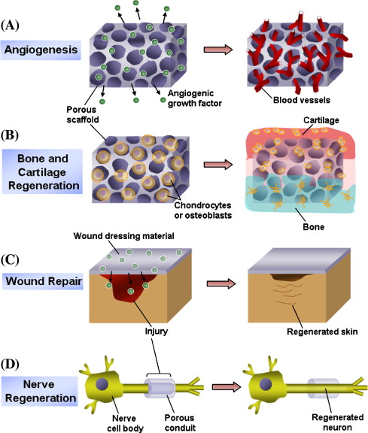
Υγεία
Κυτταρική θεραπεία
Νανοιατρική

Slide 22
Σας ευχαριστώ

Slide 23
BioMedical Informatics in H2020 (III)
Excellence in Science base
Link with relevant flagship (s) if any (ITFoM?)
Bottom-up research activities
Industrial competitiveness
Link and use the generic ICT technologies

