Slide 2


About Us
Competence Center for Emerging Smart Networks & Services
Competence Centers are private-public partnerships designed to bridge the gap between supply and demand of specialized innovation and technology transfer services in one or more value chains.
p-NET is the first Competence Center in Greece for Emerging Smart 5G / 6G Networks and Services.
A private company recently incorporated in the region of Western Greece.

Slide 3





How it all started
  Public funding
Action “Competence Centers”
Call 029ΚΕ - Α/Α ΟΠΣ 4397
  Coordinator
  Private funding
Network of Partners – Universities, Research Institutions, Industry, Large Companies, SMEs
.

Slide 4


Our funding
Co-financed by Greece and the European Union
Total Initially Budgeted Funding of 2.210.900€
- Public Funding of 1.334.450€
- Funding of 876.450€ from Private Sector

Slide 5
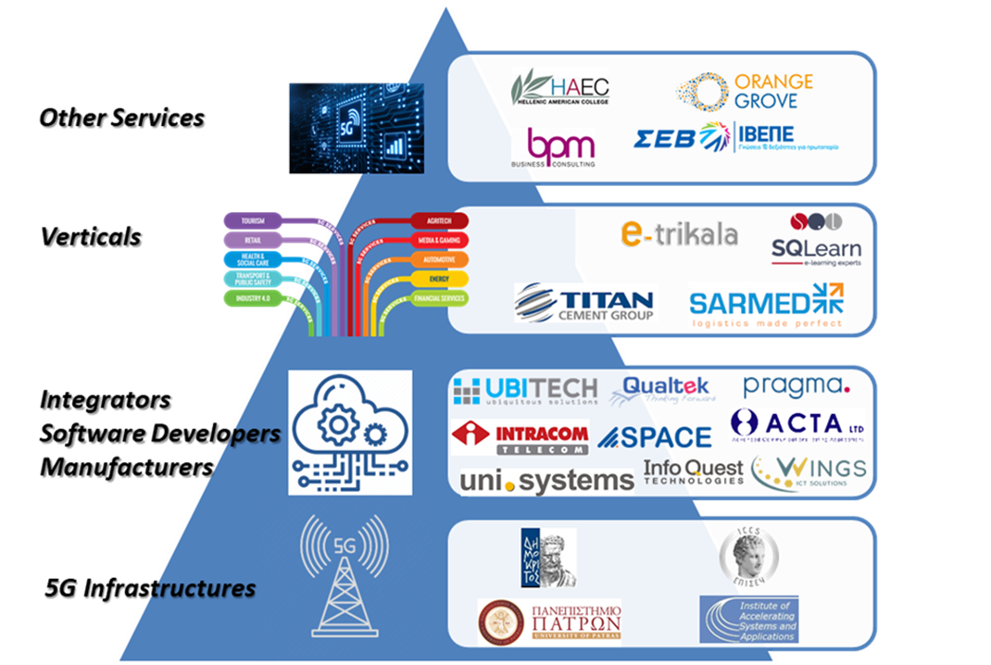
Our Stakeholders

Slide 6

Our Mandate
The mandate of p-ΝΕΤ as a Competence Center is to:
Support innovation in sectors of the Greek economy, through
the provision of specialized and innovative services & products, and
technology transfer to businesses, especially SMEs.

Slide 7
Our Objectives
3.
  Added value to businesses
Orientation of businesses to products and services of high added value,
Exploitation of comparative advantages,
Development of extroverted entrepreneurship.
1.
  Promotion of innovation and exchange of knowledge & expertise
Promotion of innovation, dissemination of information and exchange of knowledge and expertise,
Sharing of facilities and equipment,
Creation of networks, and cooperation with businesses and other Competence Centers.
4.
  Training businesses
Training of businesses to acquire skills in the industry sector necessary for the implementation of new technologies in real/pilot production conditions,
Contribution to the technological and digital transformation of businesses.
2.
  Transfer of technological solutions
Transfer of technological solutions and innovations in production processes
Awareness raising and adoption of new technologies in business, to improve their competitiveness.
.
5.
  Innovative research
Implementation of innovative research and service/product development projects.

Slide 8
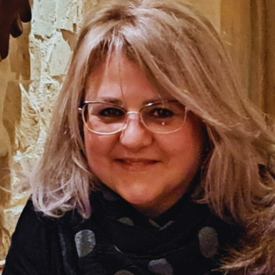
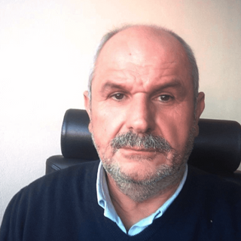
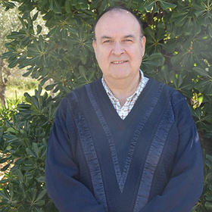
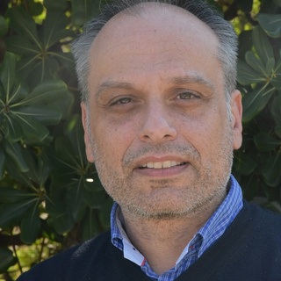
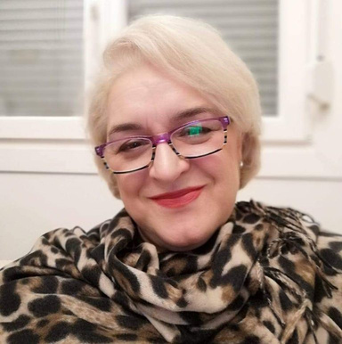
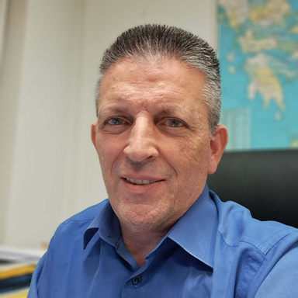
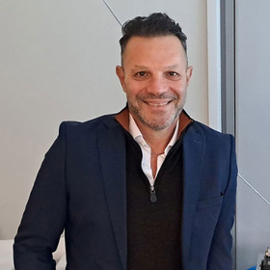

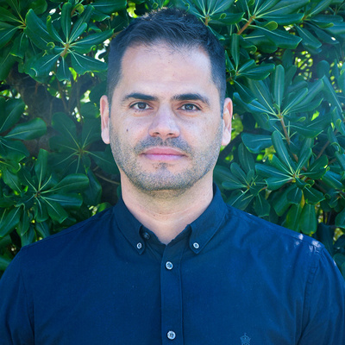
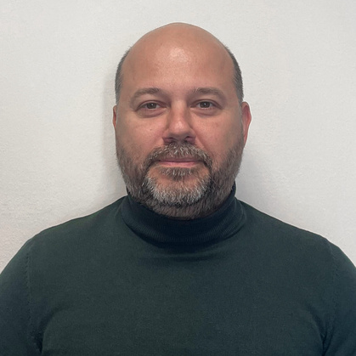

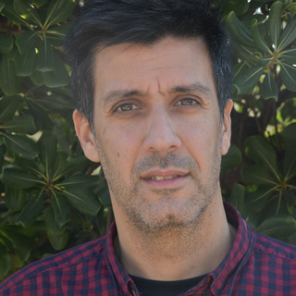
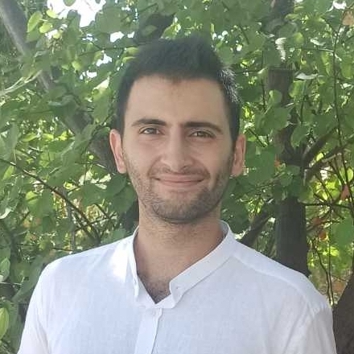
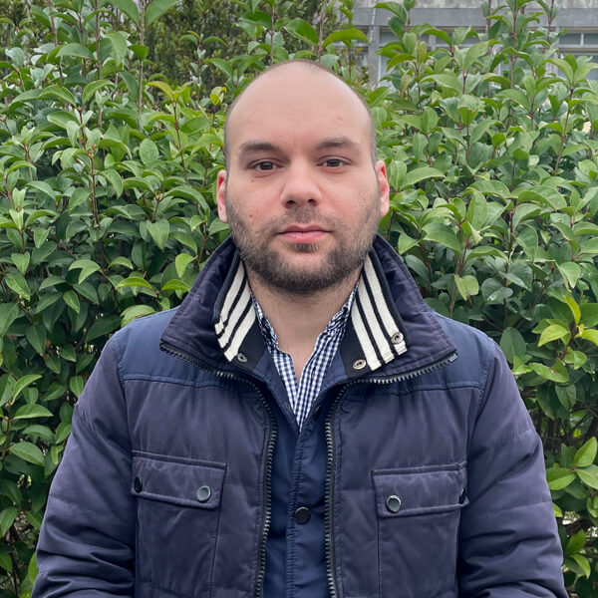
Our Team
Didoe Prevedourou
Prof. Alexios Birbas
Prof. Spyros Denazis
Dr. Christos Tranoris
Maria Votta
Managing Director
Academic & Business Consultant
Scientific Coordinator
Technical Director
Head of Office, Co-funded Projects Management
George Kotronis
Marios Nicolaou
Roula Ioannou
Charalabos Gizas
Panos Kapos
Finance Director
Business Development Director
Head of Education & Training
Telecoms and 5G Radio Engineer
Cloud Infrastructure Engineer
Dr. Konstantinos Lampropoulos
Andreas Polychronopoulos
Nikolaos Polyzogopoulos
Konstantinos Pournaras
Senior Security Engineer
Senior Cloud Infrastructure Engineer
Junior Front-End Web Developer
Junior Networks Engineer

Slide 9

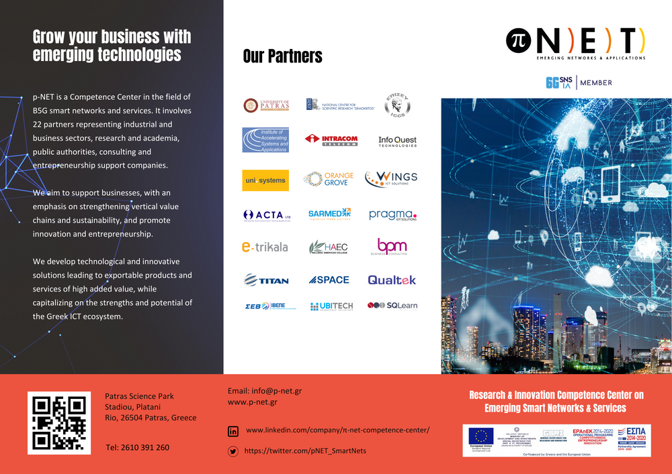
Our Digital Presence
Website: https://www.p-net.gr
Brochure for marketing purposes describing p-NET’s purpose, services and partners.

Slide 10


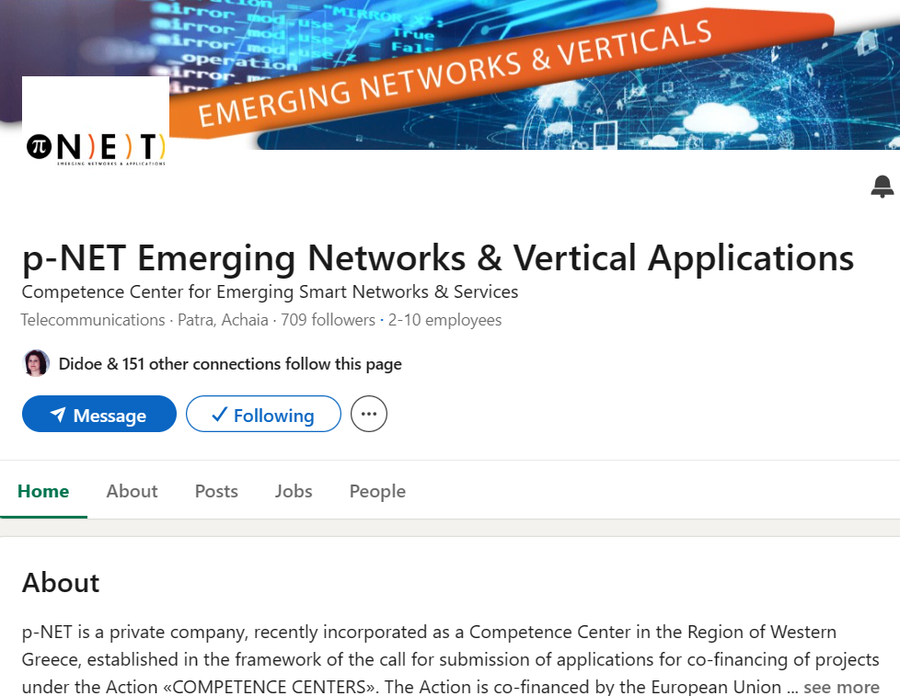
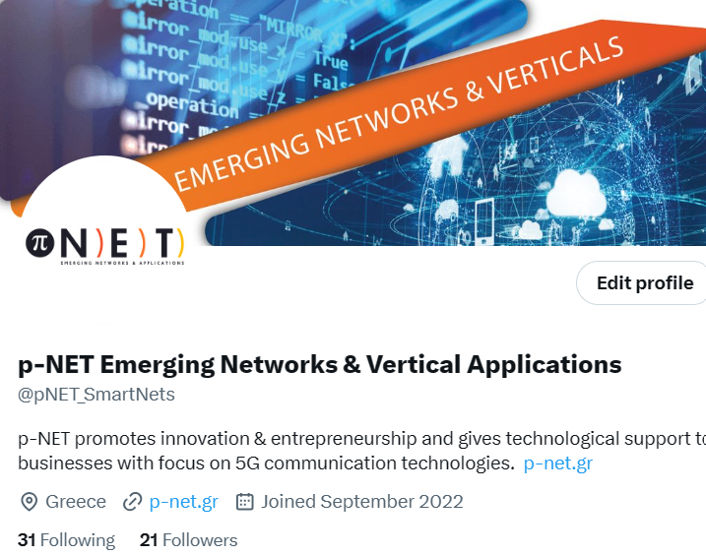
Social Media
www.linkedin.com/company/π-net-competence-center/
https://twitter.com/pNET_SmartNets

Slide 11
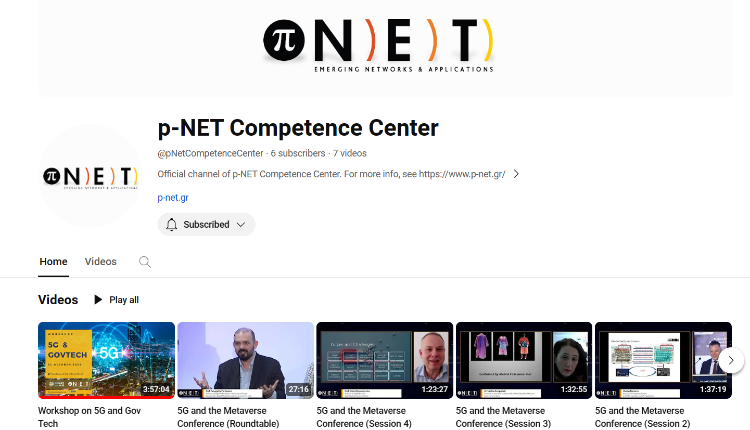

Social Media
p-NET Competence Center - YouTube

Slide 12

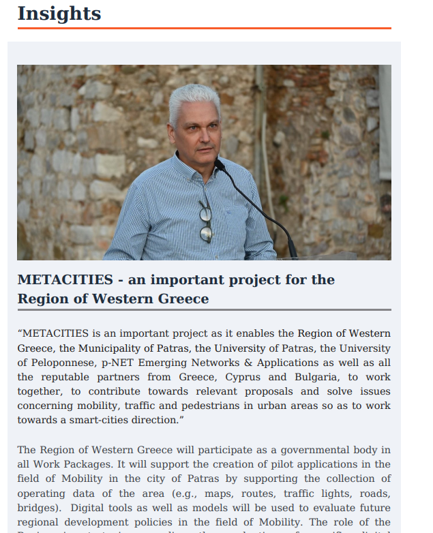
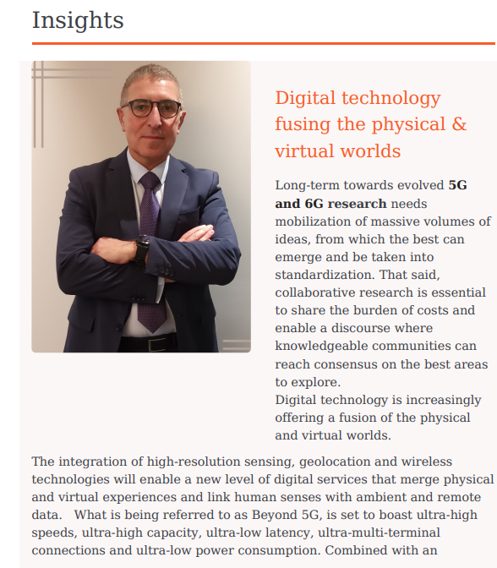
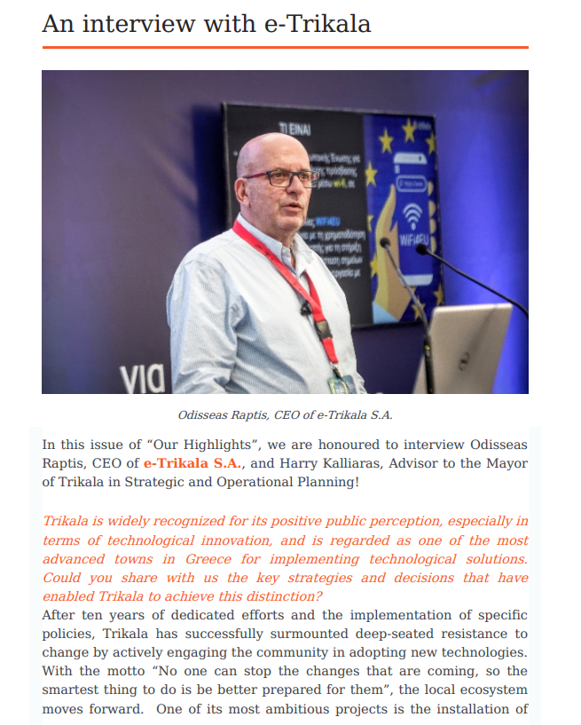
e-Newsletter ‘Our Highlights’
P-NET’s e-Newsletter ‘Our Highlights’ provides all the Competence Center’s latest news and events and gives insights and updates from its partners.

Slide 13
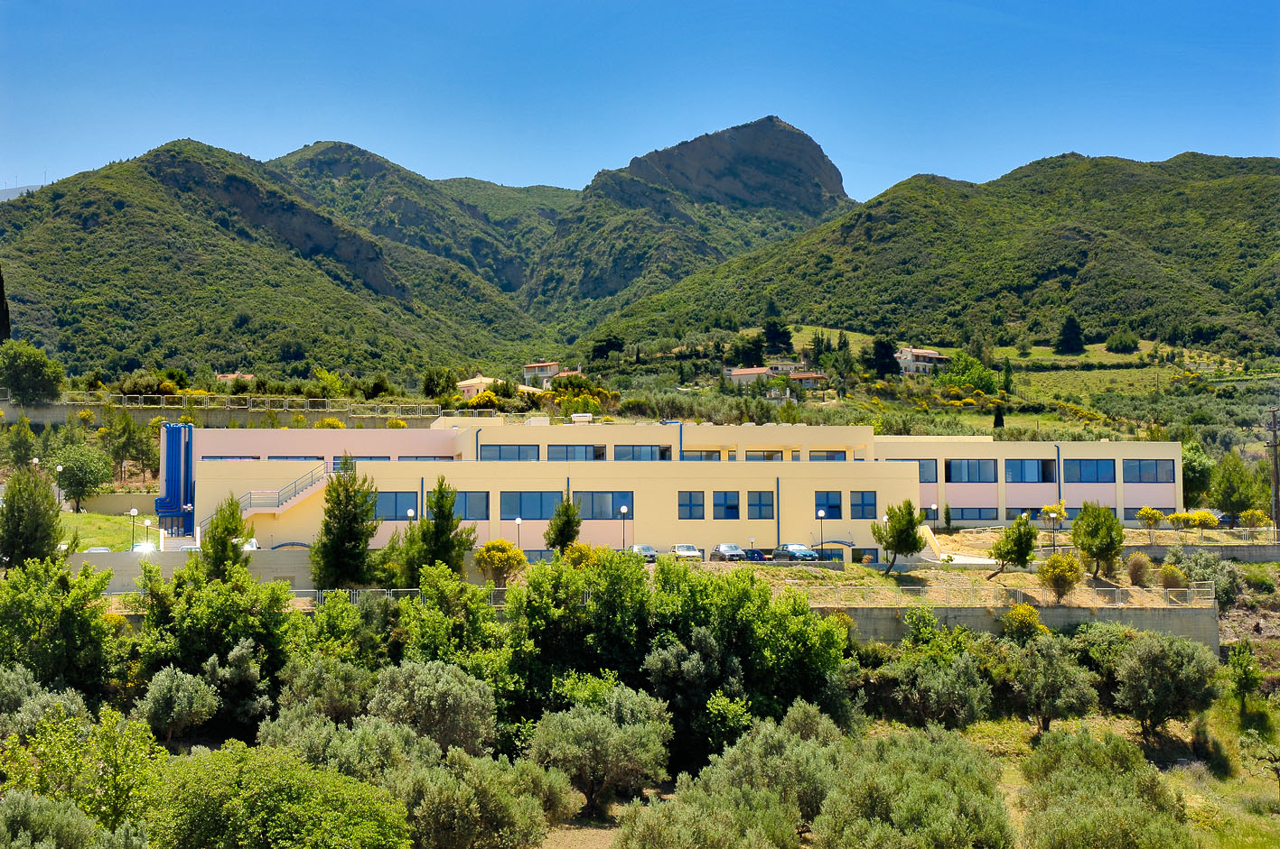

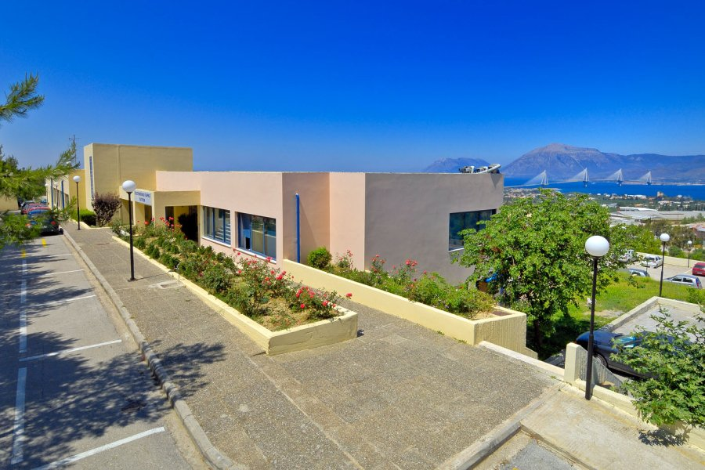
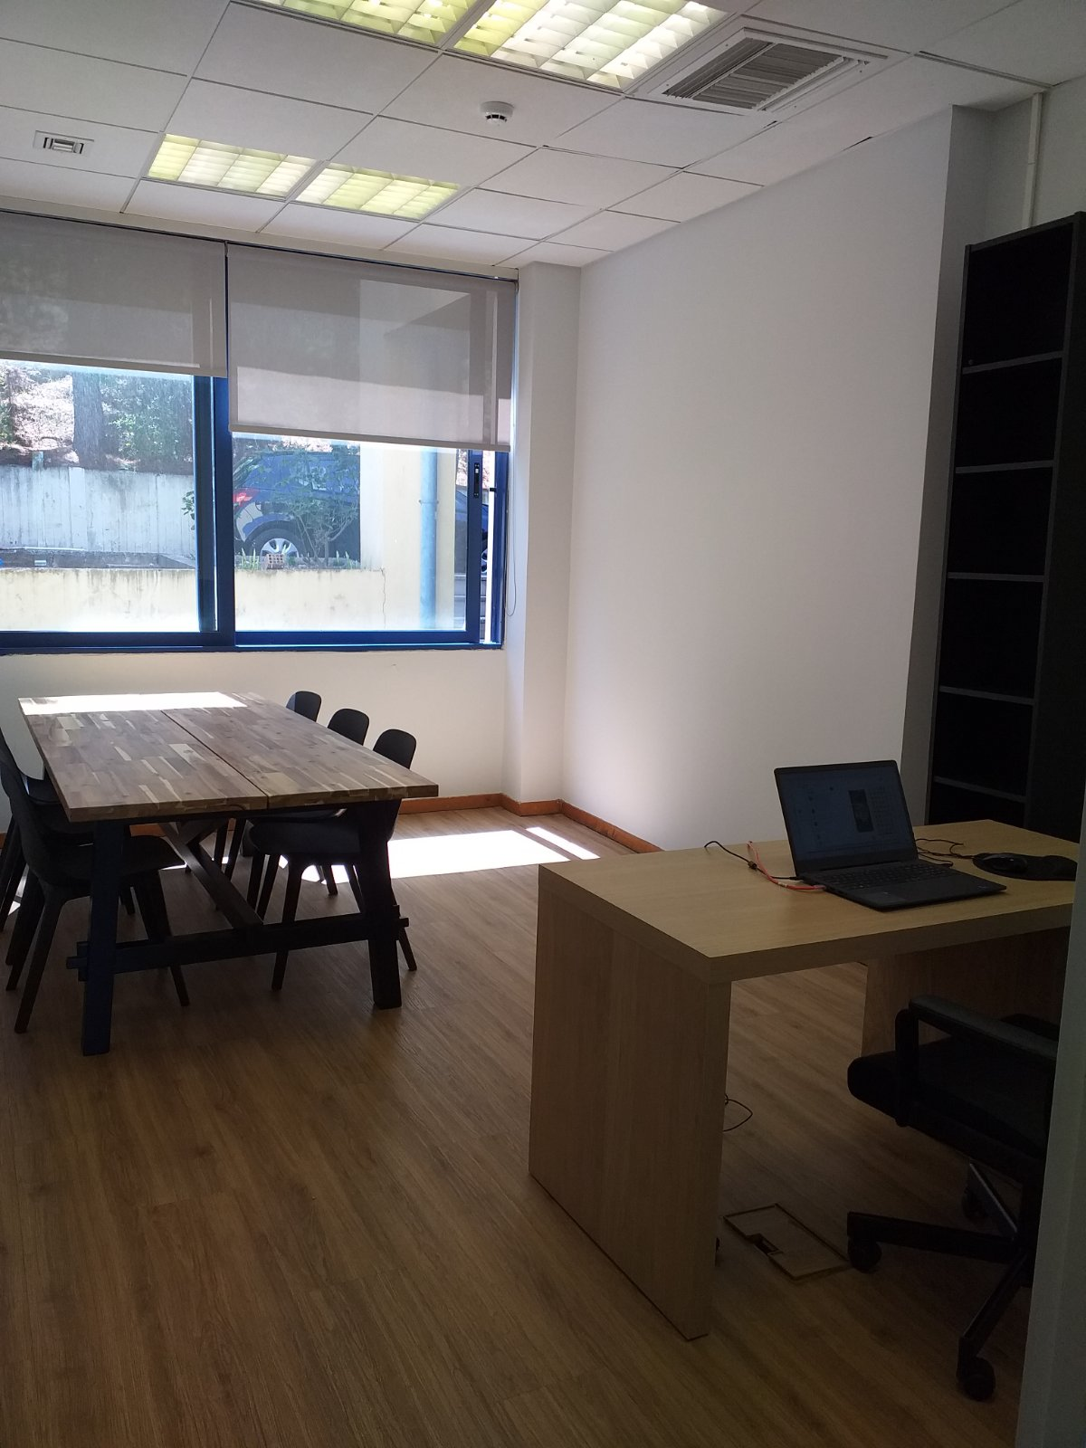
Our Facilities
p-NET is located at the Patras Science Park (PSP) facilities.
PSP is a Science and Technology Park operating under the auspices of the General Secretariat for Research and Technology (GSRT).

Slide 14
Research & Innovation
A horizontal, very important activity, the results of which are expected to feed and create added value for all processes and activities of the Competence Center.
National and EU collaborative RIA
  HORIZON-JU-SNS R&I,
  HE CL2, CL3, CL4, CL5 & WIDERA Calls
  DEP
  Open Calls (cascaded funding)
  RRF, ESPA, [E-K] Programs
Expected Benefits
  Research and technological development beyond SOTA
  Enrich infrastructure
  Enrich service and product portfolio
  Enrich and continuously update technology transfer services
  Enrich and continuously update education and upskilling training
  Expand network of collaborators

Slide 15






ΕU Collaborative Projects
EU Collaborative Projects
CURRENTLY RUNNING PROJECTS
https://metacities-hub.com/
P-NET Funding ~ 1.300Κ€
https://fidal-he.eu/
https://across-he.eu/
https://custodes-project.eu/
https://natwork-project.eu/
  SAND5G: Security Assessments for Networks anD Services in 5G
https://sand5g-project.eu/
p-ΝΕΤ role
Experiments, pilots, field trials, demos, assessments
Capacity Building
Open Calls
Research and Innovation
Conformity assessment capabilities of Composite ICT products or ICT services
https://indux-r.eu/

Slide 16
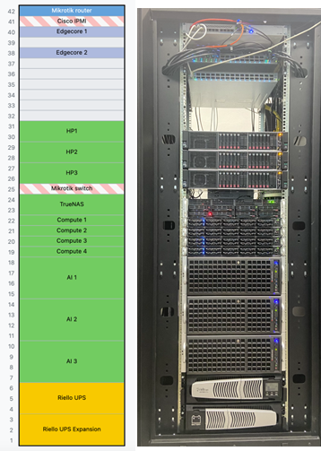
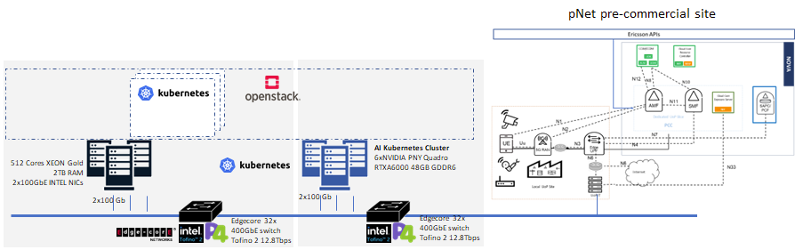
Lab Infrastructure

Slide 17





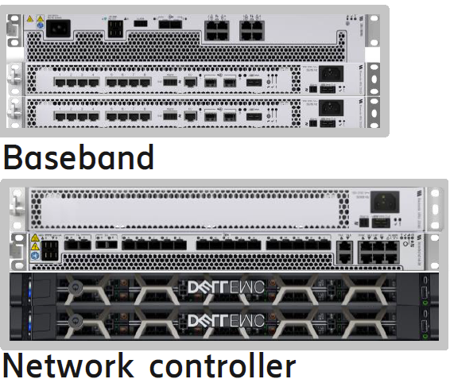


Private 5G core
Ericsson APIs
premises (ready by Q4 2023)
CCSM/CCDM
Cloud Core
Resource Controller
NFVI LAB
ENM
UDR
AUSF
UDM
NRF
NSSF
SAPC/
PCF
N12
N10
N8
N7
pre-commercial site/Patras premises (ready by Q1 2024)
Cloud Core
Exposure Server
AMF
N11
SMF
Dedicated UoP Slice
PCC
NEF
Ericsson Dots NR
Edge
UPF
N4
Ericsson Micro NR
N6
Internet
N33
to Patras5G DC

Slide 18







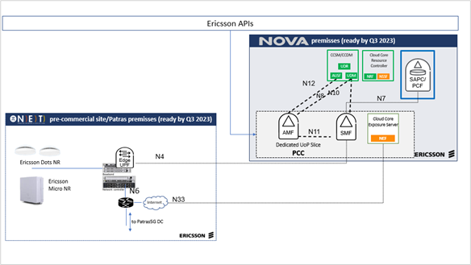










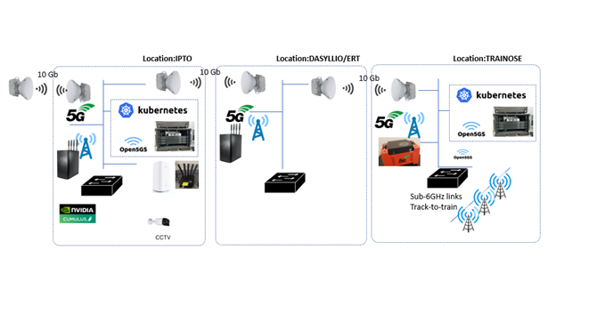






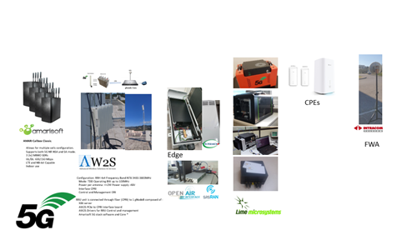
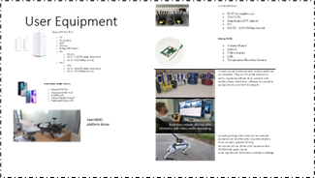
Integrated Patras 5G & p-NET Infrastructure
Verticals
Applications
p-NET pre-commercial site
Helm VNF
repository
Monitoring
AI Kubernetes Cluster
6xNVIDIA PNY Quadro RTXA6000 48GB GDDR6
512 Cores XEON Gold
2TB RAM
2x100GbE INTEL NICs
2x100 Gb
2x100 Gb
Edgecore 32x 400GbE switch Tofino 2 12.8Tbps
Edgecore 32x 400GbE switch Tofino 2 12.8Tbps
450 Cores XEON Gold
1.5 TB of RAM
80 Gb
10 Gb
1 Gb
Internet
https://www.p-net.gr/
https://wiki.patras5g.eu/
5G NR (SA)

Slide 19


Services
Private 5G Core Infrastructure
Technological Solutions
Education & Professional Training
Support and promotion of innovation and entrepreneurship
Awareness Raising

Slide 20
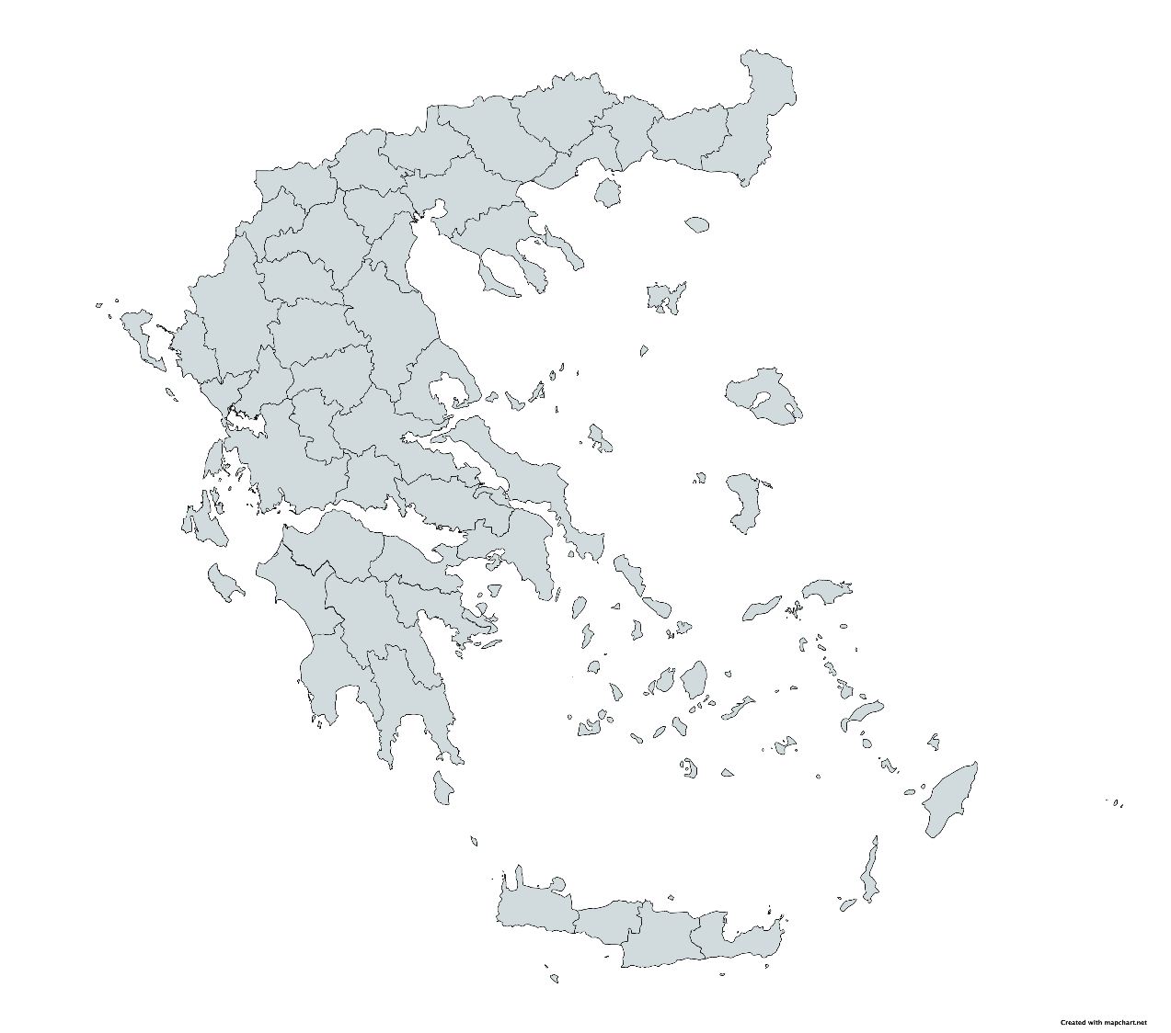




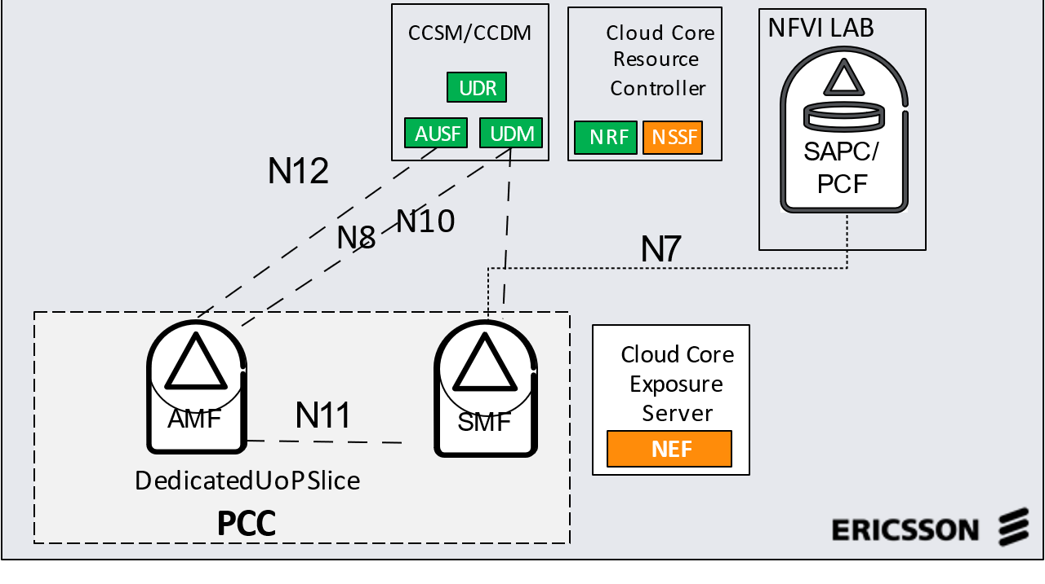
p-NET National 5G/6G Infrastructure
2024-2028
In a Box
5G+/6G experimentation
Equipment vendors e.g. conformance
New 5G/6G functionality
KPI/KVI Measurements
Integration Testing
E2E Trials
Small Scale Vertical use cases deployment
Training
Core
In a Box
In a Box

Slide 21









First Users
Our 5G/6G Testbed is already being used in Research and Innovation Projects
Users
Use Cases
p-NET’s role
Media, First Responders, Sports
>10 use cases in Digital Twin, XR, PPDR
5G Testbed, Design, Implementation
Provider 1
Media, Conference Organisers
Live Media XR Conferences
5G Testbed, Consulting
MoU has been signed with
5G ventures and a collaboration
Framework has been established
for testing development,
co-assessments, knowledge and
technology transfer.
Municipalities, Citizens
Smart Mobility
5G Testbed, Integration, Consulting
R&D Organisations
Continues Network Security
5G Testbed, Security Consulting
SAND5G
R&D Organisations
5G Risk and Security
Network Security Consulting
R&D Organisations
Zero touch provisioning and orchestration
5G Testbed, Service Provisioning
Telecom Company
5G Cybersecurity Certification
5G Testbed, Security Consulting

Slide 22
Technological Solutions
Manufacturing
Retail
Supply Chain - Logistics
Maritime
Health
Education
Local Government
Media
Culture - Tourism
Discovery of opportunities that adopting 5G technologies and solutions could bring to businesses
Specialized expertise in (co-)designing and (co-)developing 5G technology solutions and services and solutions for Vertical industries.
Integration of p-NET’s infrastructure and services with the specific infrastructures, user equipment and services of Verticals
Holistic, collaborative Development Model

Slide 23
Support to Greek Industry and Economy
p-ΝΕΤ objective is to identify and implement the applications of 5G and Emerging Technologies which are most relevant and beneficial to the Greek Industry and Economy. During the last 2 years we have performed an extensive scan across developed countries to identify sectors and use cases which are most relevant to our focus technologies. We gathered these findings and started dynamic discussions with Industry, State and Academia to gather their input and create a shortlist of target vertical sectors and the relevant applications. We also held 2 conferences during 2023 which included focused roundtables with the relevant stakeholders.
As a result, we identified the following sectors and relevant technologies
Sector | Comms Technologies | Emerging Technologies | Priority (start date)
Culture, Tourism, Education | 5G, Private 5G, Slicing, Wifi | XR, Metaverse, Geospatial tech | High (2024)
Public Protection Disaster Relief (PPDR) | 5G, Slicing, Satellite | XR, Drones, IoT, Digital Twins | High (2024)
Maritime and Logistics | Private 5G, Satellite | Edge AI, IoT, Cameras, Drones | Medium (2025)
Smart Cities / Islands | WAN 5G, Spectrum Share | Digital Twins, IoT, Drones | Medium (2025)

Slide 24
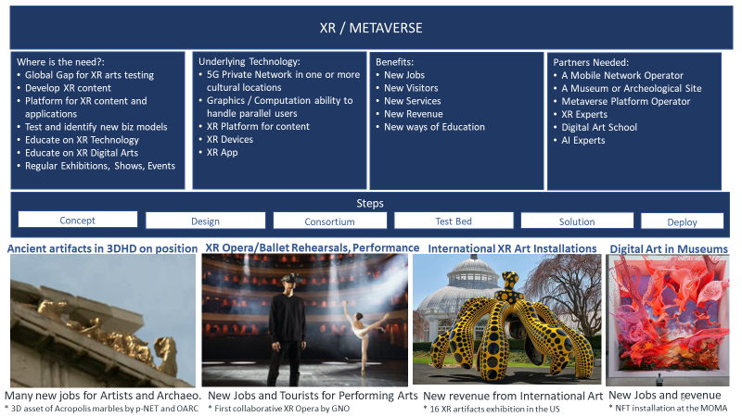
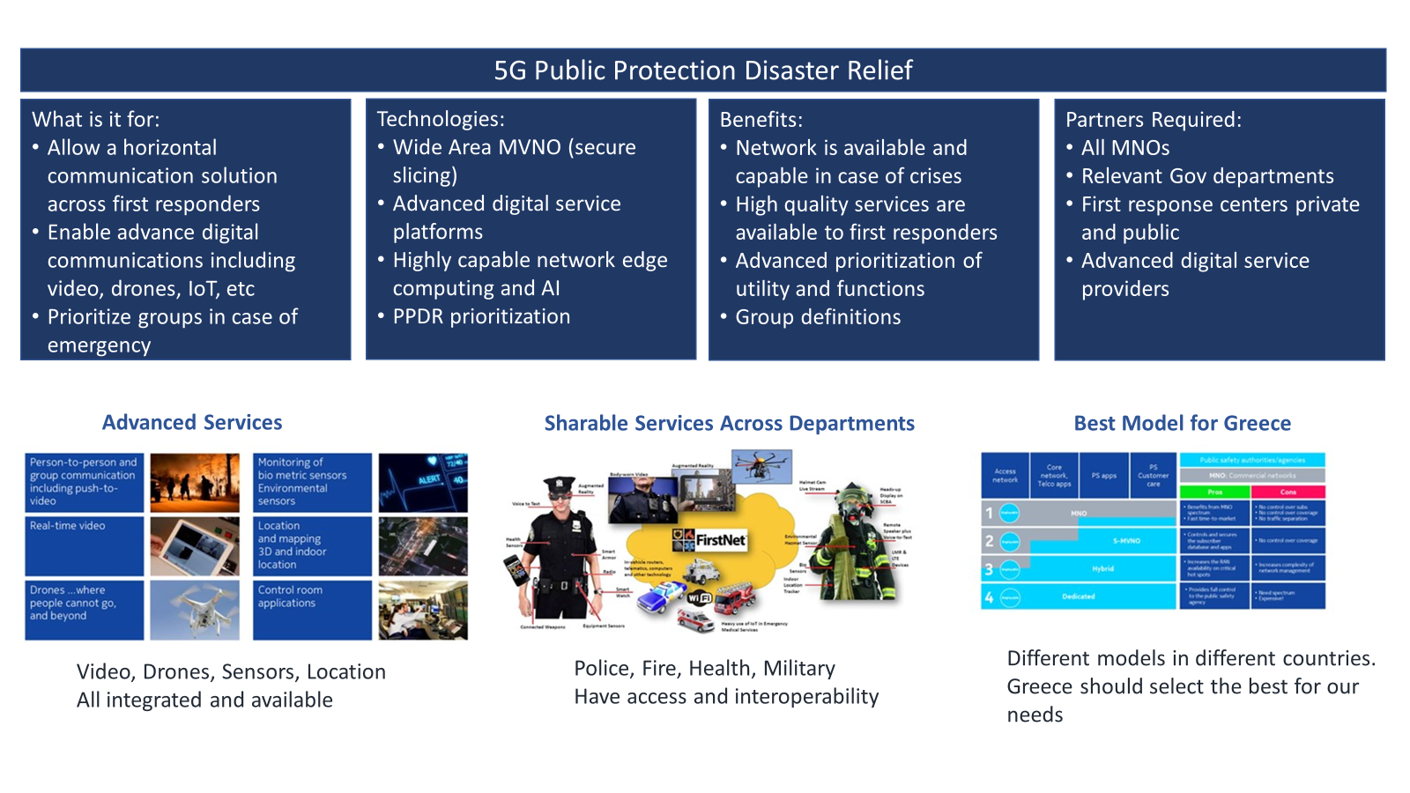
High Priority Focus Sectors (2024 - 2025 Focus)
Following all our discussion and engagement of the industry it became obvious that the best initial focus area is on XR and the Metaverse for applications in Culture, Tourism and Education. This can enable new revenues, new jobs, and new visitors for Greece. As such we have forged new partnerships with Global leaders in this and namely OpenAR Cloud, the Metaverse Standards Forum and Unity.
A 2nd focus area for 2024 is on PPDR. It is well known that this area is of outmost importance to Greece given the various disasters which happen in our country annually. There are important new technological advancements which can greatly affect and help the First Responders in such disasters such as Firefighters, Policemen, etc. As such we have partnered with local and international expert for collaboration within 2024

Slide 25
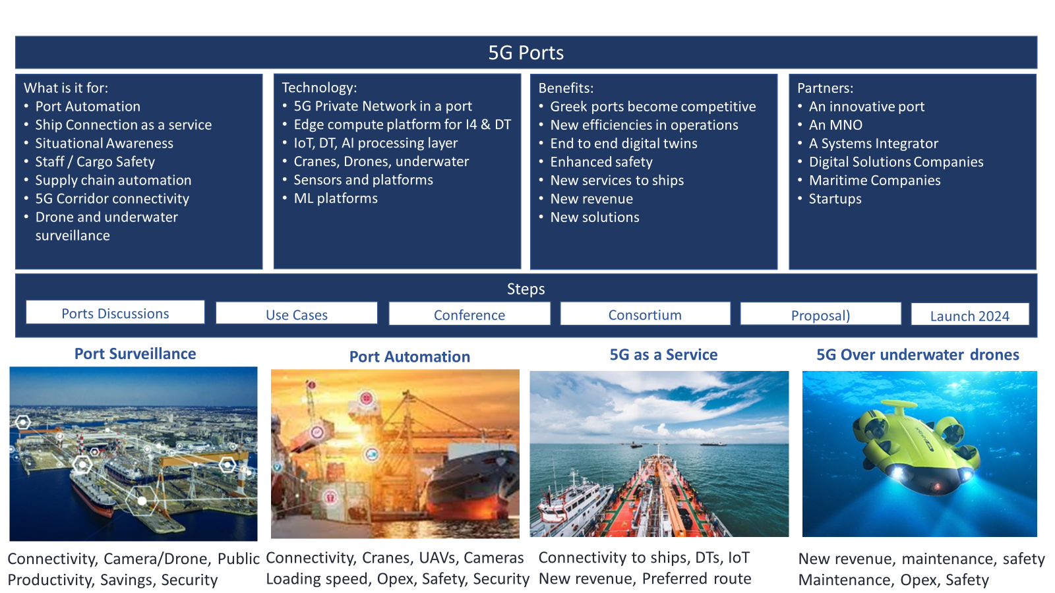
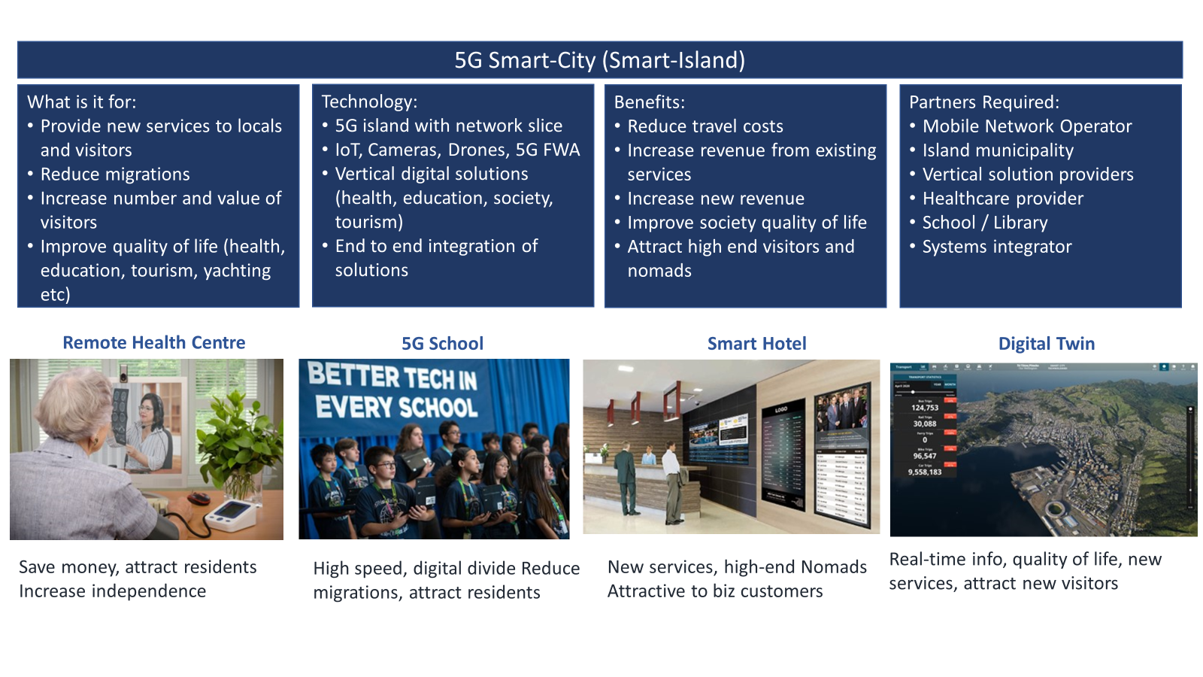
Additional Focus Sectors (end of 2025 to 2026)
Greece is an international superpower when it comes to shipping and maritime. During our international and local discussions, we identified the need for new technologies to be implemented in Greek ports and Corridors. For this reason, we have performed a high-level study to identify the relevant use cases and potential partners for projects. We are currently in discussions with Greek ports but also international players. Project will likely start 2025+
Given the large number of islands and remote communities of Greece it is essential that we use new technologies to help the residents and visitors to these locations enjoy new digital services. For this reason, it is our vision that we will work the relevant stakeholders to explore the possibilities. We note it as a focus area, and we will keep exploring possibilities and partnerships for real projects within 2025

Slide 26





Memberships
p-NET is a member of the NetworldEurope SME Working Group, the voice and networking place for the NetworldEurope SME community.
p-NET is a member of the 6G Smart Networks and Services Industry Association, the voice of European Industry and Research for Next Generation Networks and Services.
p-NET is a member of InnoAgora, the Matchmaking Platform for Innovative Greek Companies and Investors, with its goal to become the reference point and gateway for innovative Greek companies looking for Greek and foreign investors and business partners.
p-NET is a member of the Federation of Enterprises & Industries
of the Peloponnese and Western Greece.
Open AR Cloud's mission is to drive the development of open and interoperable
spatial computing technology, data and standards to connect the physical
and digital worlds for the benefit of all.

Slide 27
Education & Professional Training
There is a surge in the global demand for 5G professionals across verticals and the telecoms ecosystem.
The integration of Cloud Computing infrastructure and virtualization
methods in the design of NGNs leads to integration of computing and
networking. This fact completely changes the application and software
development requirements, also leading to a paradigm shift in the way
new verticals applications, solutions and services are designed and developed. .
Upskilling training programs are addressed to:
Tech professionals working in industries implementing 5G technologies and applications
Tech professionals in the telecom ecosystem building and operating 5G network solutions .

Slide 28
Education & Professional Training
Indicative Training courses include:
  5G Foundation: Network Elements and 2G to 5G and beyond evolution
  5G Implementation: Open-Source Systems, Network Deployment in Cloud
  Future of Mobile Communications: Role of AI/ML/IoT
  Cybersecurity
  XR and Metaverse Technologies
  Sustainability and Social Responsibility
  Innovation and Entrepreneurship

Slide 29
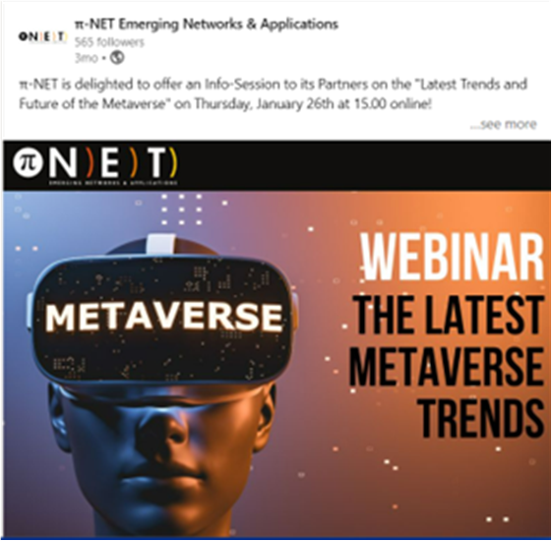

Support & promotion of innovation and entrepreneurship
Holistic Start-up Support
  Training
  Co-creation of technological solutions
  Tests, pilots, validation support infrastructure
  Business Planning, Fund raising and Go-to-Market Support
Consulting – Advising addressed to:
  Businesses
  State Authorities
Dissemination and Awareness Raising addressed to:
  Scientific Community
  Business World
  Civic World
  with the use of various channels:
    Conferences, seminars, webinars, open information events;
    Social media, web, brochures, newsletters, email campaigns, press releases.

Slide 30
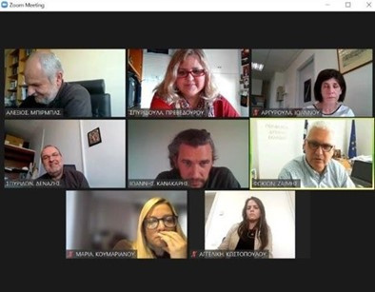
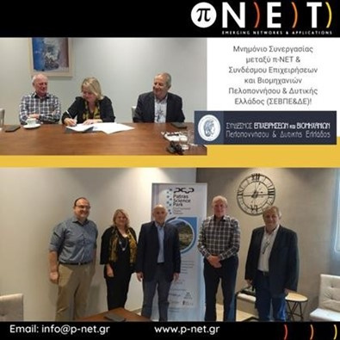
Synergies & Networking
Co-operation with Region of Western Greece in submission of EU funded projects and in implementing an EU funded project entitled METACITIES.
A Memorandum of cooperation has been signed with the Federation of Enterprises & Industries of the Peloponnese and Western Greece (Σύνδεσμος Επιχειρήσεων και Βιομηχανιών Πελοποννήσου & Δυτικής Ελλάδος).

Slide 31
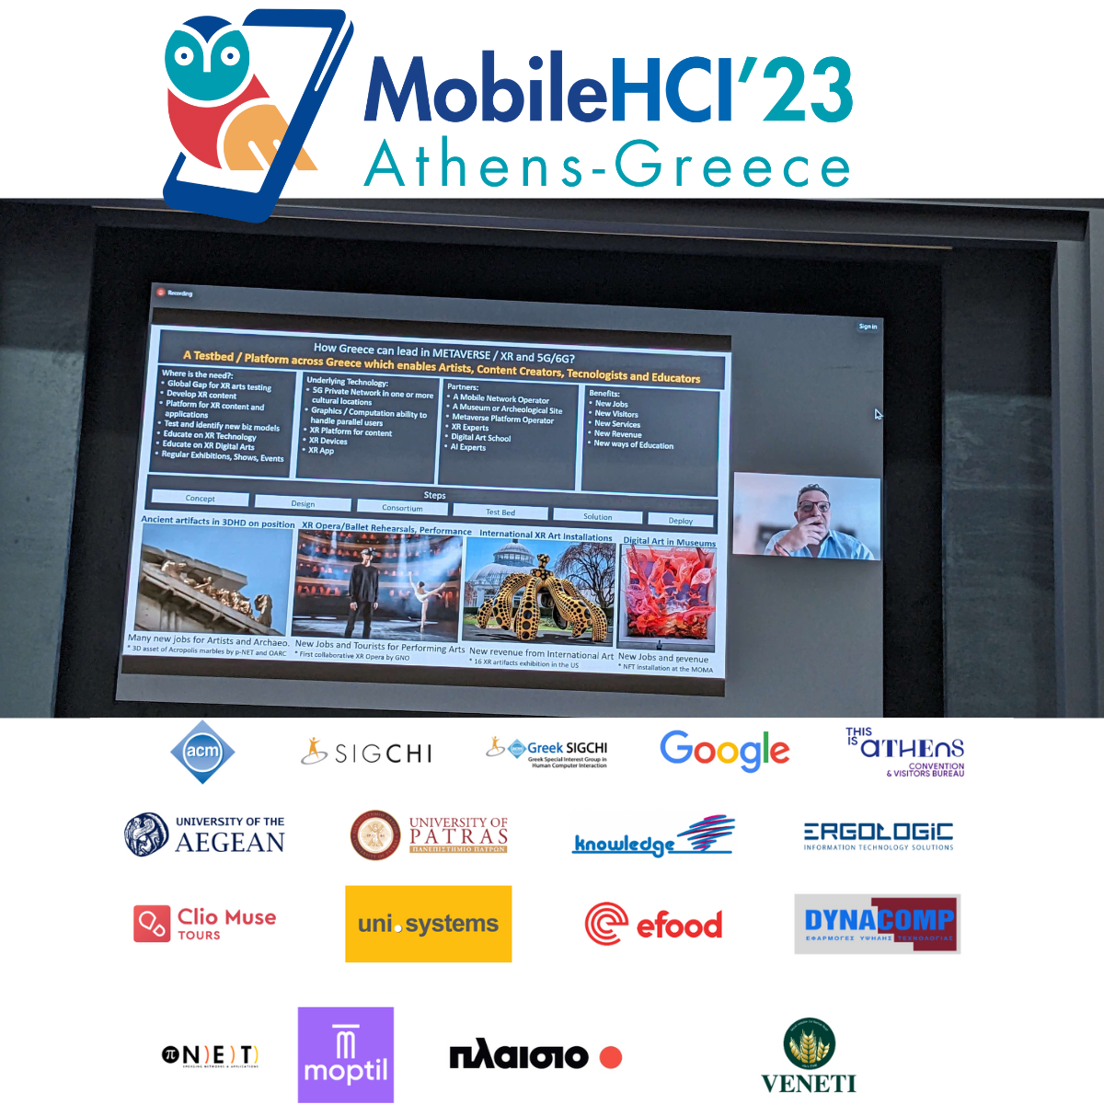

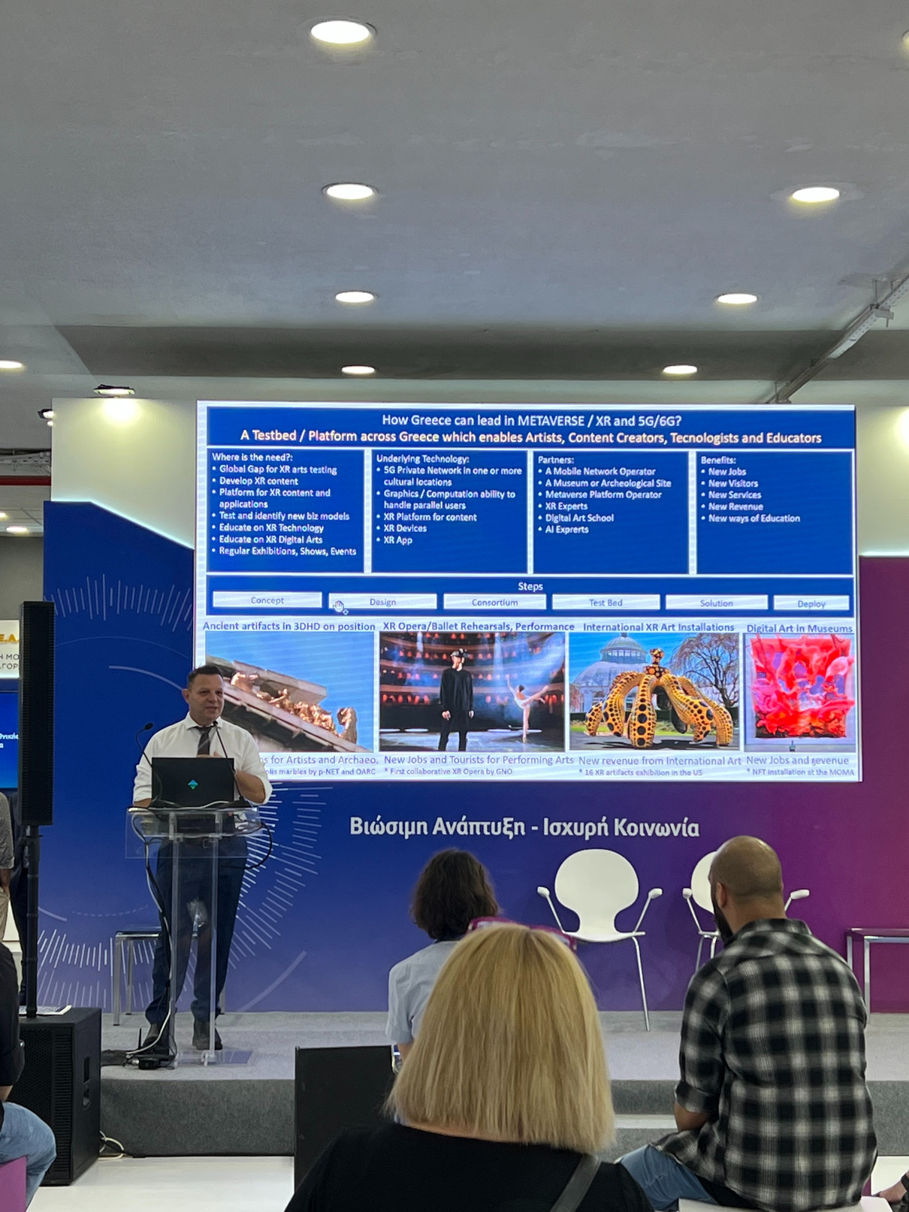
Participation in Conferences & Events*
Presentation by Christos Tranoris, Technical Director
12th Mobile Connected World Conference
July 2022
Presentation by Marios Nicolaou on ‘Smart Networks & Services Empowering Business Verticals’
The ACM International Conference on Mobile Human-Computer Interaction - Mobile HCI ‘23 where p-NET was a sponsor.
September 2023
Presentation by Marios Nicolaou on ‘5G and the Metaverse’
87th Thessaloniki International Fair
September 2023
* The events highlighted in this presentation are just a selection from many

Slide 32
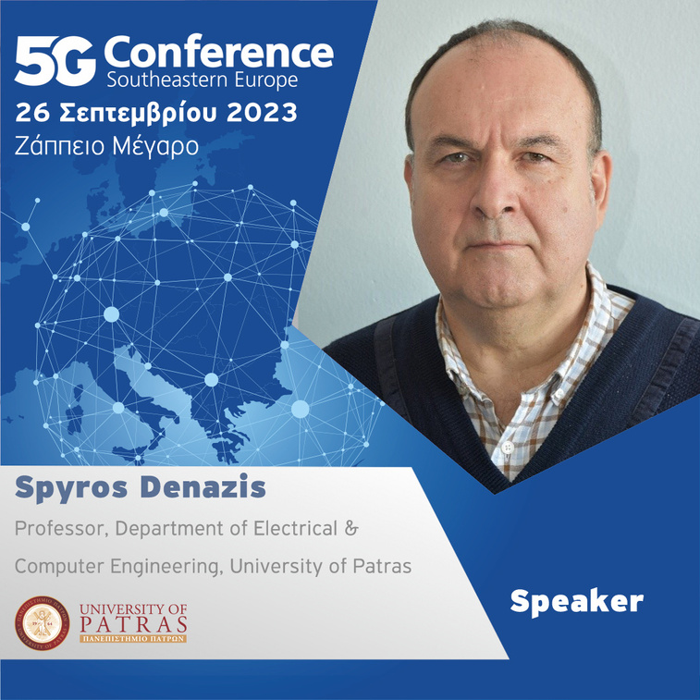
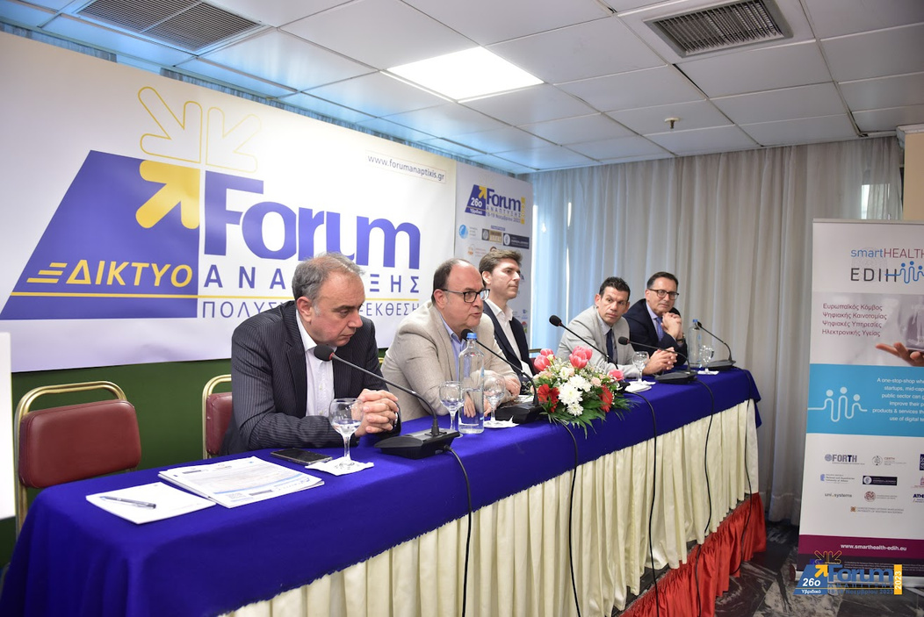
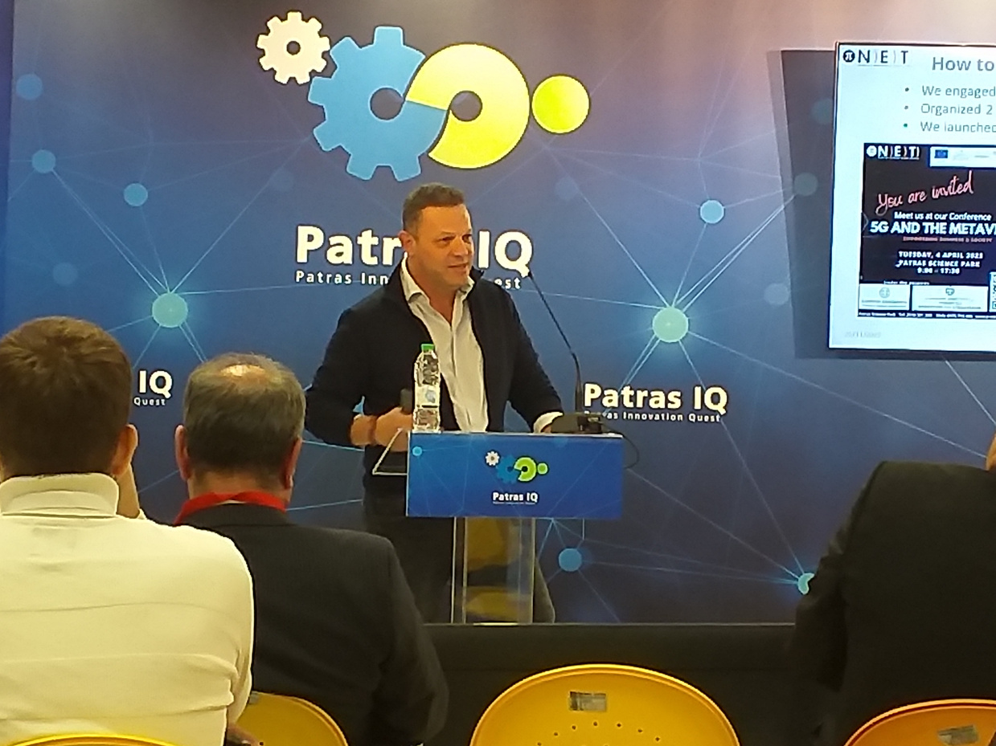
Presentation by Prof. Spyros Denazis on ‘Empowering Verticals through Experimentation’
5G Conference Southeastern Europe
September 2023
Presentation by Prof. Spyros Denazis on ‘Open Network infrastructures as a means of Research & Innovation’
SmartHEALTH Workshop
26th Forum Ανάπτυξης
November 2023
Presentation by Marios Nicolaou
Κέντρα Ικανοτήτων: Καταλύτης Ανάπτυξης και Αξιοποίησης Καινοτομίας
Patras IQ 2023
November 2023
* The events highlighted in this presentation are just a selection from many

Slide 33
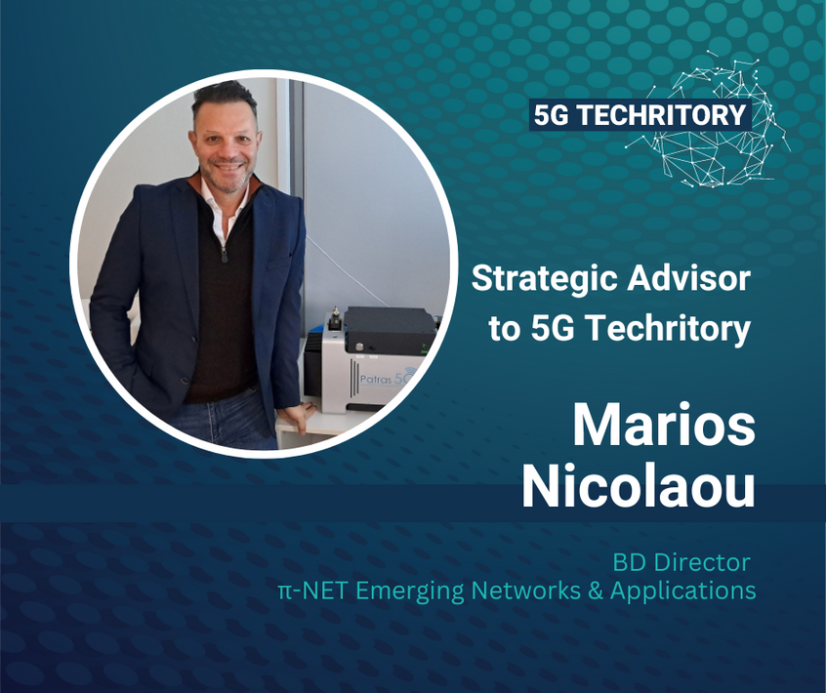
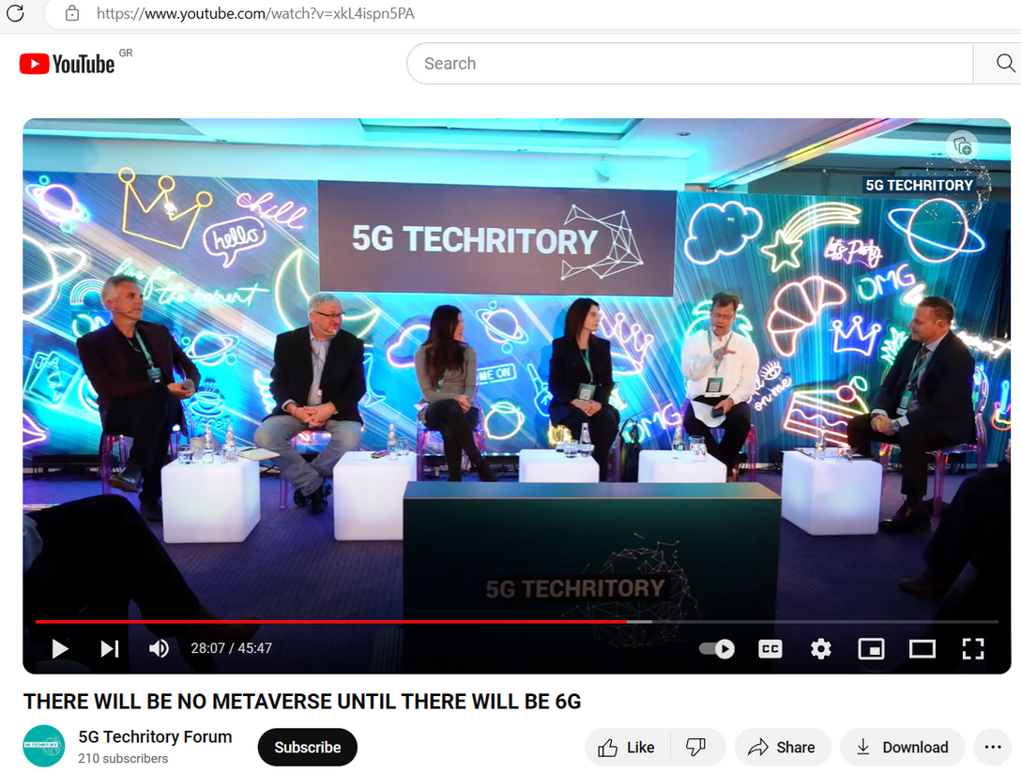
Apart from being appointed as a Strategic Advisor to the 5G Techritory, Marios Nicolaou was appointed as Coordinator of the Opening Panel Discussion ‘Digitilization through Connectivity - Outlook for 2024’, with panelists Audrey Plonk, Head of the Digital Economy Policy Division - OECD, Jaroslaw Ponder, Head of the ITU Office for Europe, International Telecommunication Union, and Zaneta Vegnere, Deputy Head of Cabinet of Executive Vice-President Dombrovskis, European Commission.
October 2023

Slide 34
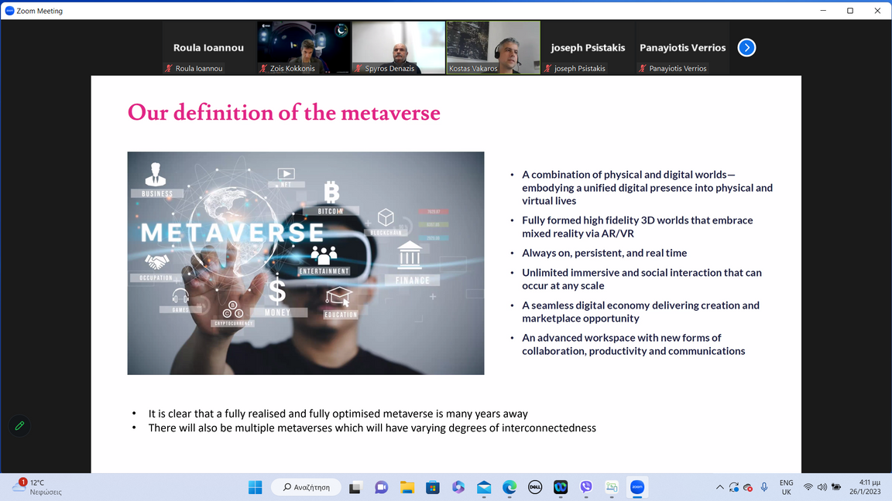
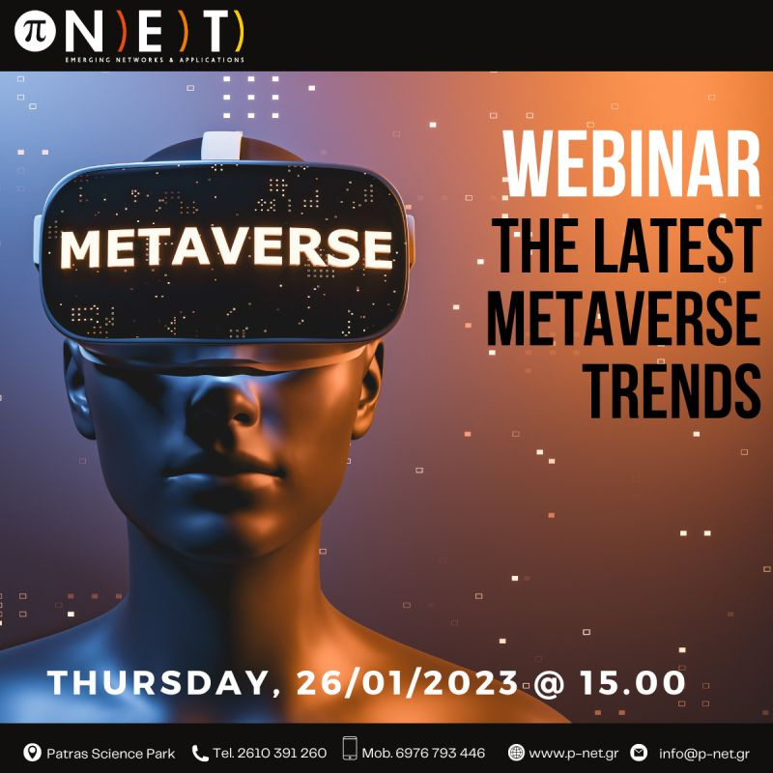
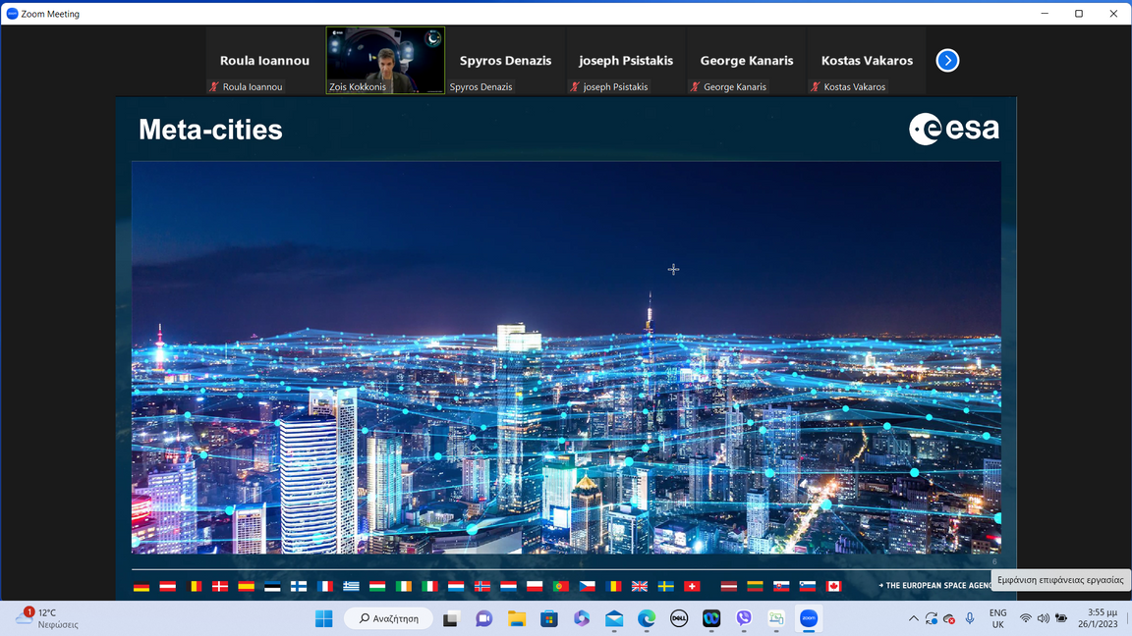
Organization of Conferences
Webinar on ‘The Latest Metaverse Trends’
Online
January 2023

Slide 35
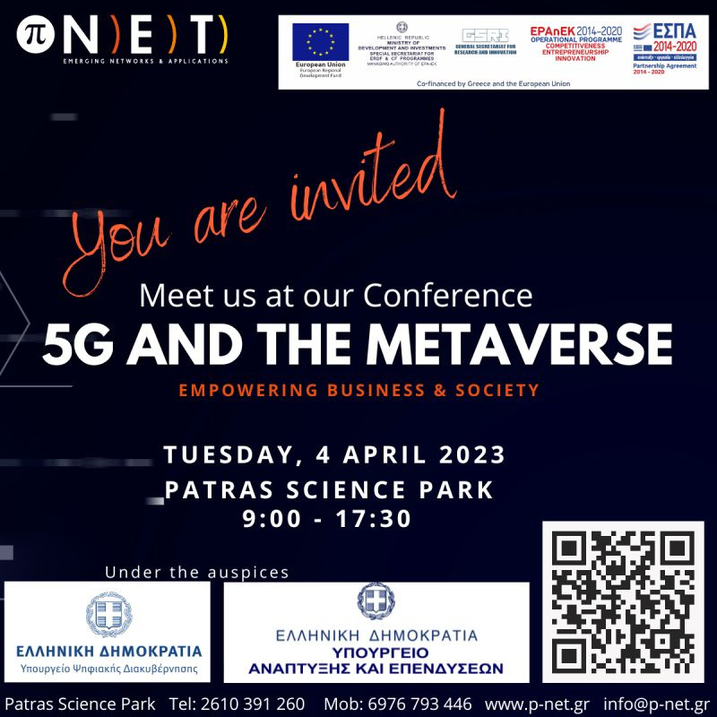



5G and Metaverse Conference
Patras Science Park
April 2023

Slide 36




Workshop on ‘5G & GovTech’
Organized in cooperation with the European Digital Innovation Hub for Digital Governance (GR digiGOV-innoHUB, Foundation of the Hellenic World, October 2023

Slide 37



Media Highlights
p-NET’s 5G and the Metaverse Conference attracted international interest, based on which an interview with Dr. Christos Dimas, Former Deputy Minister for Development and Investments was organized and an article published in Forbes!
Greece Aims For Olympian Heights With 5G And Beyond (forbes.com)
Marios Nicoalou gave an interview to Ionian TV journalist, Tasos Theodosis on p-ΝΕΤ’s goals and activities and how it can contribute towards the development of the Region of Western Greece.
https://www.youtube.com/watch?v=4vjsvUMyEZ8&feature=youtu.be
Former Deputy Minister for Development, Dr. Christos Dimas promoted an article on p-NET, its activities and goals and how it can, through its innovative products and services, contribute to the development of the Region of Western Greece.

Slide 38





Contact Us
(+30) 2610 391 260
info@p-net.gr
https://www.p-net.gr
Patras Science Park
Stadiou, Platani, Rio
Patras, Greece

Slide 39

Thank you !

